Slide 1

Fee for Service, Marketplace: Plans, Metal Level
Fee for Service: Providers are paid for each service performed
e.g. tests, office visits.
Marketplace Healthcare - The difference between the plans is what percentage of the cost of care they cover (for example, Bronze plans cover 60% of the costs, where Gold covers 80%; this may vary from state to state.) The plans that cover more have higher monthly premiums.
Plan type
Exclusive Provider Organization (EPO)
Health Maintenance Organization (HMO)
Point of Service (POS)
Preferred Provider Organization (PPO)
Metal levels are available for each type
Platinum
Gold
Silver
Bronze
https://www.wahbexchange.org/current-customers/know-your-plan/
https://www.healthcare.gov/choose-a-plan/plan-types/
https://www.healthmarkets.com/resources/health-insurance/struggling-navigating-health-insurance-exchange
https://www.healthmarkets.com/resources/health-insurance/struggling-navigating-health-insurance-exchange/
/
Notes:
Exclusive Provider Organization (EPO): A managed care plan where services are covered only if you use doctors, specialists, or hospitals in the plan’s network (except in an emergency).
Health Maintenance Organization (HMO): A type of health insurance plan that usually limits coverage to care from doctors who work for or contract with the HMO. It generally won't cover out-of-network care except in an emergency. An HMO may require you to live or work in its service area to be eligible for coverage. HMOs often provide integrated care and focus on prevention and wellness.
Point of Service (POS): A type of plan where you pay less if you use doctors, hospitals, and other health care providers that belong to the plan’s network. POS plans require you to get a referral from your primary care doctor in order to see a specialist.
Preferred Provider Organization (PPO): A type of health plan where you pay less if you use providers in the plan’s network. You can use doctors, hospitals, and providers outside of the network without a referral for an additional cost.

Slide 2
Providers: Plans – Bronze, Silver, Gold, Platinum
Exclusive Provider Organization (EPO): A managed care plan where services are covered only if you use doctors, specialists, or hospitals in the plan’s network (except in an emergency).
Health Maintenance Organization (HMO): A type of health insurance plan that usually limits coverage to care from doctors who work for or contract with the HMO. It generally won't cover out-of-network care except in an emergency. An HMO may require you to live or work in its service area to be eligible for coverage. HMOs often provide integrated care and focus on prevention and wellness.
Point of Service (POS): A type of plan where you pay less if you use doctors, hospitals, and other health care providers that belong to the plan’s network. POS plans require you to get a referral from your primary care doctor in order to see a specialist.
Preferred Provider Organization (PPO): A type of health plan where you pay less if you use providers in the plan’s network. You can use doctors, hospitals, and providers outside of the network without a referral for an additional cost.
https://www.healthcare.gov/choose-a-plan/plan-types/
Notes:
There are different types of Marketplace health insurance plans designed to meet different needs. Some types of plans restrict your provider choices or encourage you to get care from the plan’s network of doctors, hospitals, pharmacies, and other medical service providers. Others pay a greater share of costs for providers outside the plan’s network.
Types of Marketplace plans
Depending on how many plans are offered in your area, you may find plans of all or any of these types at each metal level – Bronze, Silver, Gold, and Platinum.

Slide 3
Capitation
The payment of a fee to a provider such that the amount paid is determined by the number of patients, students, or customers.
Used by managed care organizations to control costs
Physician at financial risk for services provided
Measure resource utilization in physician practices
Report measures of health care quality
Can be linked to financial rewards, such as bonuses
Amounts are in per person per month
For more info see: “Understanding Capitation” by the American College of Physicians by Dr. Patrick Alguire https://www.acponline.org/about-acp/about-internal-medicine/career-paths/residency-career-counseling/guidance/understanding-capitation
https://www.acponline.org/about-acp/about-internal-medicine/career-paths/residency-career-counseling/guidance/understanding-capitation
Notes:
Capitation payments are used by managed care organizations to control health care costs. Capitation payments control use of health care resources by putting the physician at financial risk for services provided to patients. At the same time, in order to ensure that patients do not receive suboptimal care through under-utilization of health care services, managed care organizations measure rates of resource utilization in physician practices. These reports are made available to the public as a measure of health care quality, and can be linked to financial rewards, such as bonuses.
Capitation is a fixed amount of money per patient per unit of time paid in advance to the physician for the delivery of health care services. The actual amount of money paid is determined by the ranges of services that are provided, the number of patients involved, and the period of time during which the services are provided. Capitation rates are developed using local costs and average utilization of services and therefore can vary from one region of the country to another. In many plans, a risk pool is established as a percentage of the capitation payment. Money in this risk pool is withheld from the physician until the end of the fiscal year. If the health plan does well financially, the money is paid to the physician; if the health plan does poorly, the money is kept to pay the deficit expenses.
When the primary care provider signs a capitation agreement, a list of specific services that must be provided to patients is included in the contract. The amount of the capitation will be determined in part by the number of services provided and will vary from health plan to health plan

Slide 4
Value Based Care
Hospital Value-Based Purchasing (HVBP)
Part of CMS ongoing work to structure Medicare’s payment system to reward providers for the quality of care they provide.
The program adjusts payments to hospitals under the Inpatient Prospective Payment System (IPPS), based on the quality of care they deliver.
https://www.cms.gov/Medicare/Quality-Initiatives-Patient-Assessment-Instruments/hospital-value-based-purchasing/index.html?redirect=/hospital-value-based-purchasing/
http://www.jantoo.com/cartoons/keywords/health-insurance
Notes:
With fee-for-service, doctors and hospitals are paid based on the number of health care services they deliver, such as tests and procedures. Payment generally has little to do with whether their patients' health improves. But what does that mean for you? Avalue-based approach is designed around patients.
Hospital Value-Based Purchasing
Hospital Value-Based Purchasing (HVBP) is part of our ongoing work to structure Medicare’s payment system to reward providers for the quality of care they provide. This program adjusts payments to hospitals under the Inpatient Prospective Payment System (IPPS), based on the quality of care they deliver.
How Hospital VBP works
How hospitals perform on quality and resource use measures is linked to the IPPS. The IPPS makes up the largest share of Medicare spending, affecting payment for inpatient stays in approximately 3,000 hospitals across the country.
Hospital VBP rewards acute care hospitals with incentive payments for the quality of care they give to people, not just the quantity of services they provide. Congress authorized the Inpatient Hospital VBP in Section 3001(a) of the Affordable Care Act. The program uses the hospital quality data reporting infrastructure that was developed for the Hospital Inpatient Quality Reporting (IQR) Program, authorized by Section 501(b) of the Medicare Prescription Drug, Improvement, and Modernization Act of 2003.
Value-Based Purchasing (VBP) is part of the Centers for Medicare & Medicaid Services' (CMS') long-standing effort to link Medicare's payment system to a value-based system to improve healthcare quality, including the quality of care provided in the inpatient hospital setting.
Hospital Value-Based Purchasing
Hospital Value-Based Purchasing (HVBP) This program adjusts payments to hospitals under the Inpatient Prospective Payment System (IPPS), based on the quality of care they deliver.
How Hospital VBP works
How hospitals perform on quality and resource use measures is linked to the IPPS. The IPPS makes up the largest share of Medicare spending, affecting payment for inpatient stays in approximately 3,000 hospitals across the country.
Hospital VBP rewards acute care hospitals with incentive payments for the quality of care they give to people, not just the quantity of services they provide. Congress authorized the Inpatient Hospital VBP in Section 3001(a) of the Affordable Care Act. The program uses the hospital quality data reporting infrastructure that was developed for the Hospital Inpatient Quality Reporting (IQR) Program, authorized by Section 501(b) of the Medicare Prescription Drug, Improvement, and Modernization Act of 2003.

Slide 5

PCOR – Data Infrastructure to Support Outcomes
Building Data Infrastructure to Support Patient Centered Outcomes Research (PCOR)
The Patient Protection and Affordable Care Act of 2010 created the Patient-Centered Outcomes Research (PCOR) Trust Fund (PCORTF).
OFFICE OF THE NATIONAL COORDINATOR (ONC) PCOR Projects
Structured Data Capture (SDC)
Data Access Framework (DAF)
Patient-Generated Health Data (PGHD)
Patient Matching, Aggregating and Linking (PMAL)
Privacy and Security Framework for PCOR (PSP)
The first two projects, Structured Data Capture and Data Access Framework (DAF), have been active ONC Standards & Interoperability Initiatives since 2013. The other three projects were kicked off in 2015.
https://www.healthit.gov/policy-researchers-implementers/building-data-infrastructure-support-patient-centered-outcomes
Notes:
ONC PCOR Projects
The Office of the National Coordinator for Health Information Technology (ONC), in partnership with ASPE, has five active PCORTF funded projects that support the development and testing of a PCOR data infrastructure.
Structured Data Capture (SDC)
Data Access Framework (DAF)
Patient-Generated Health Data (PGHD)
Patient Matching, Aggregating and Linking (PMAL)
Privacy and Security Framework for PCOR (PSP)
The first two projects, Structured Data Capture and Data Access Framework (DAF), have been active ONC Standards & Interoperability Initiatives since 2013. The other three projects were kicked off in 2015.
We envision outcomes of these five projects to inform policy, standards, and services specific to the adoption and implementation of a PCOR data infrastructure.
Dr. Jamie Skipper is the point of contact for the ONC PCOR Portfolio.

Slide 6
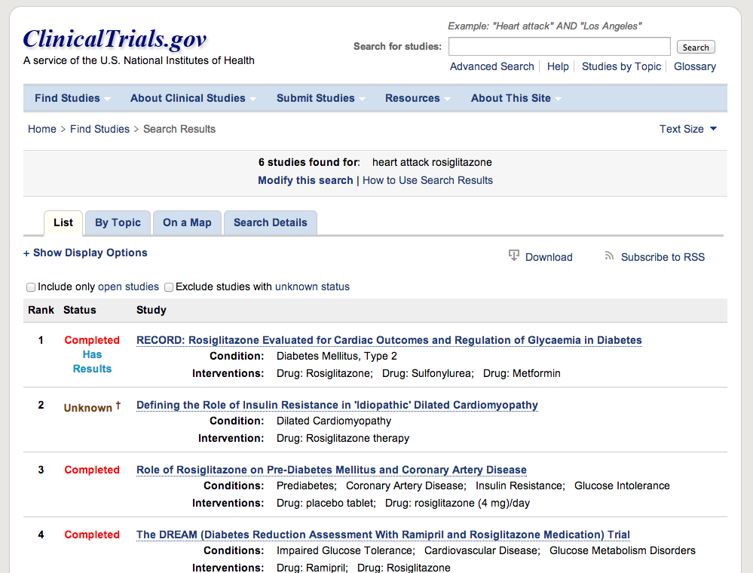
Clinicaltrials.gov

Slide 7
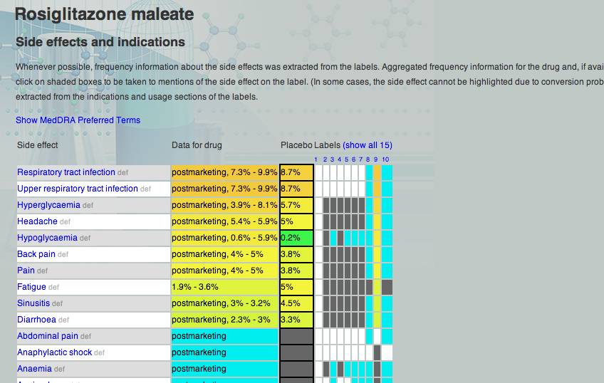
SIDER – sideeffects.embl.de

Slide 8
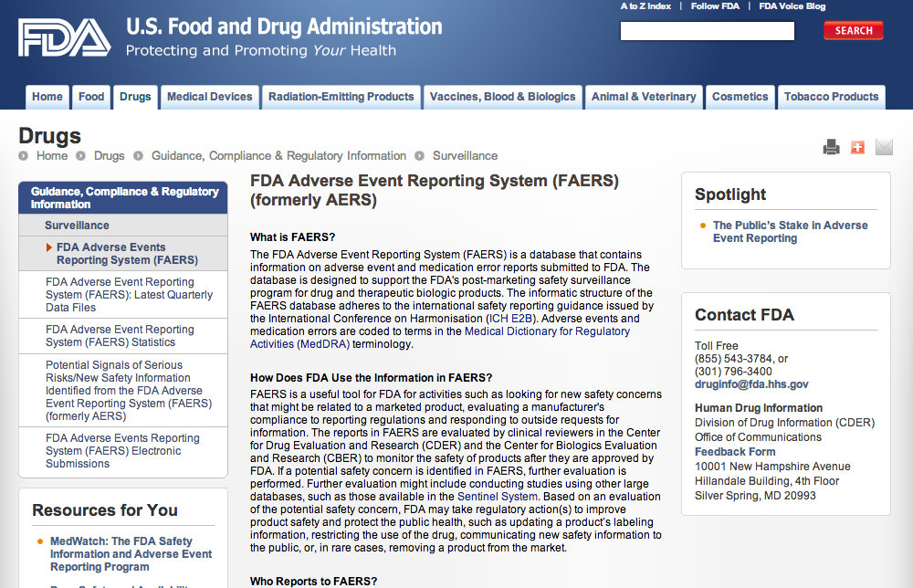
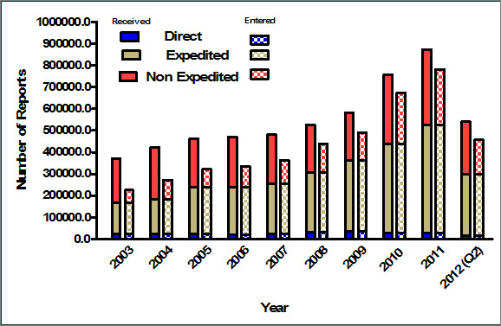
FDA Physician-reported Adverse Events (FAERS)

Slide 9
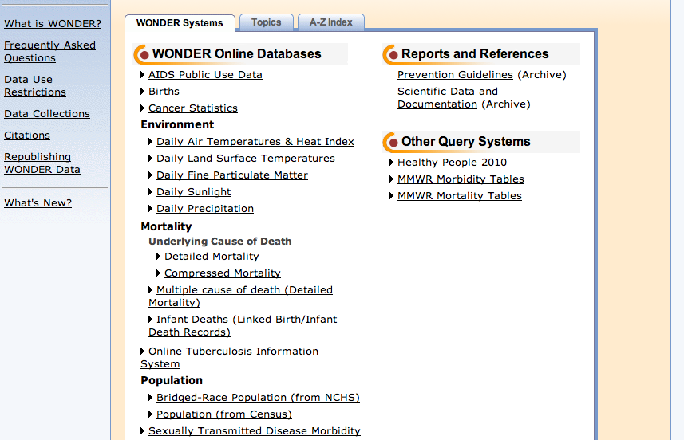
Epidemiology – e.g. CDC WONDER

Slide 10
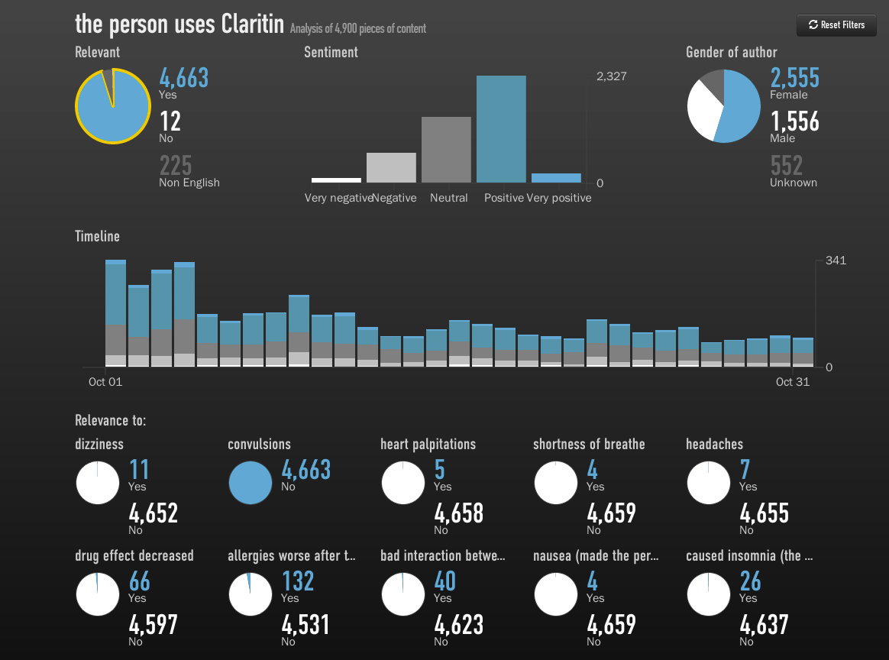
Social media extraction
http://www.crowdflower.com/blog/2013/03/discovering-drug-side-effects-with-crowdsourcing

Slide 11



HEALTH IT Acronyms and #hashtags
Acronyms, Occupations, Organizations, Twitter #hashtags
https://www.healthitanswers.net/health-it-key-acronyms/
Tweet Chats, Conferences, Diseases, Regular
A more complete list of Twitter #hashtags can be found on the
Healthcare Hashtag Project, a free open platform for patiendts, caregivers, doctors and other providers that connects them to relevant conversations and communities:
https://www.symplur.com/healthcare-hashtags/
Notes:
About the Healthcare Hashtag Project
The goal of the Healthcare Hashtag Project is to make the use of Twitter more accessible for providers and the healthcare community as a whole. By lowering the learning curve of Twitter with a database of relevant hashtags to follow, we hope to help new and existing users alike to find the conversations that are of interest and importance

Slide 12
Cartoon: Life in the US
Cartoon caption:
“There are some things
medical science cannot
explain…. like where the
hell our health care
system is heading.”
Do you think data
science has the same
limitations?

